Slide 1
Global Keywords and Namespaces

Slide 2
Introduction of global Keyword
It can be accessed within class and functions, and the value of it can be changed only for that class or function respectively.
Python global keyword is used to declare that variable in the program.
It allows the user to define a variable globally whose value can be modified outside the current scope.

Slide 3
The term global denotes that the scope of a variable declared as global will persist for the duration of the entire program’s execution.
We utilize the global keyword inside a function only when we wish to conduct value assignments or update a variable.

Slide 4
Rules of global keyword
Without the use of the global keyword, a variable created inside any function is a Local variable by default.
Variable defined outside the function is Global by default. No need to use the global keyword.
Global keyword is used when we want to read or write any global variable value inside the function.
The global keyword used for a variable declared outside the function does not have any effect on it.
In the same line, a variable cannot be declared global and assigned a value. E.g. global x = 5 is not allowed.

Slide 5
Use of global variable
Accessing Global variable from inside the function.
Updating/Modifying Global variable from inside the function.
Using the global keyword in local function to modify the global variable value.

Slide 6
Accessing Global variable from inside the function
The variable is declared outside the function i.e., globally.
We will simply fetch the variable into the local function and print it.
Example
num = 25 # Global variable def display(): print('Global Variable value inside function:', num) display()
Output:
Global Variable value inside function: 25

Slide 7
Updating/Modifying Global variable from inside the function
In this example, we try to update/change the global variable ‘roll_no’ from within the function. But the Python interpreter displays an error. This is because we can only access the global variable from within the function and not edit it.
Example
stud = 'Joshua' # Global variable roll_no = 26 # Global variable def display(): roll_no = roll_no + 2 # Updating 1 global variable in local function print('Correct Student roll_no:', roll_no) display()
Output:
Traceback (most recent call last): File "", line 9, in File "", line 5, in display UnboundLocalError: local variable 'roll_no' referenced before assignment

Slide 8
Using the global keyword in local function to modify the global variable value.
In the following example, we declared ‘roll_no’ as a global variable inside the local function.
When we increment the value of the variable in the function, it does not give any error as compared to the previous example.
Also, changing the value of the global variable inside the function display() has an effect on the value of the outside global variable too, as we can see in the below example.

Slide 9
Example
stud = 'Joshua' # Global variable roll_no = 26 # Global variable def display(): global roll_no roll_no = roll_no + 4 # Updating 1 global variable in local function print('Inside display() student roll_no value:', roll_no) display() print('Global variable roll_no value:', roll_no)
Output:
Inside display() student roll_no value: 30 Global variable roll_no value: 30

Slide 10
Python Namespace
Namespace as a mapping of every name we have defined to corresponding objects.
It is used to store the values of variables and other objects in the program, and to associate them with a specific name.
This allows us to use the same name for different variables or objects in different parts of your code, without causing any conflicts or confusion.

Slide 11
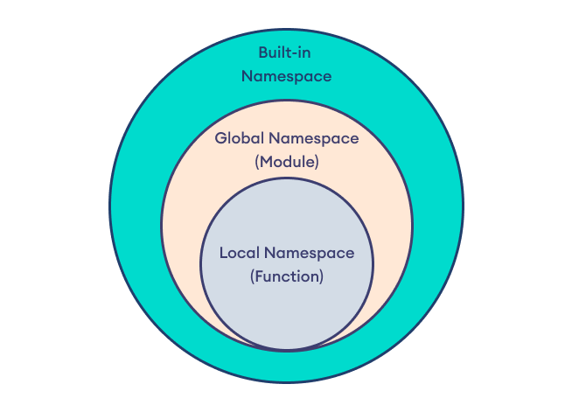
Types of Python namespace

Slide 12
Example
global_var = 10 def outer_function(): outer_var = 20
def inner_function(): inner_var = 30 print(inner_var) print(outer_var) inner_function() print(global_var) outer_function()
Output:
10
20
30

